Slide 1
Sales & Customer Dashboard
Tableau Public data visualization project: sales performance and customer behavior, selected year vs previous year

Slide 2



Project Overview
Sales Dashboard
Customer Dashboard
Interactive
Monitors sales for the selected year vs the previous year: KPIs, monthly trends, sub-categories, and weekly trends.
Understands customer behavior: KPIs, distribution by number of orders, and the top 10 customers by profit.
Select a year (automatically compared with the previous year), filter by product and location, click charts, and navigate between dashboards.
Tools: Tableau Public Data: 4 CSV files (Orders, Customers, Location, Products) Comparison: current year vs previous year

Slide 3
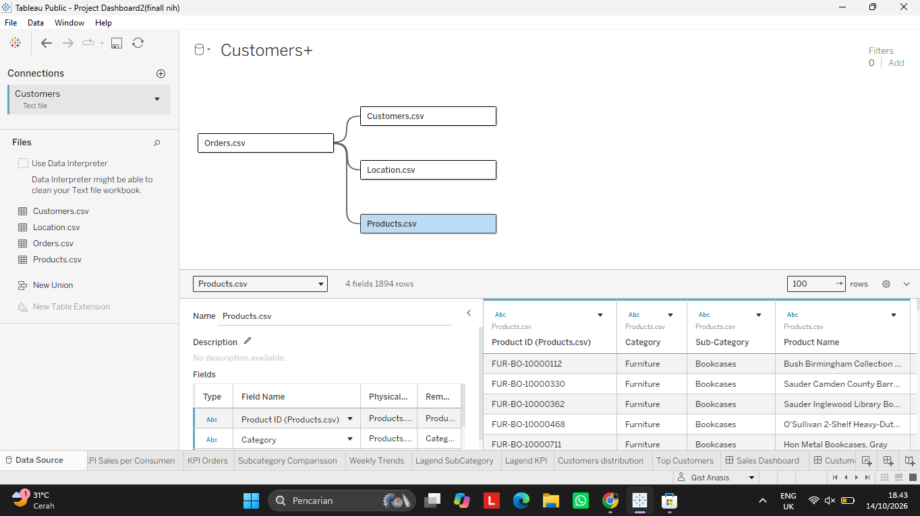
Data Source & Relationship Model
Orders
13 fields | 9,994 rows
Transactions: date, segment, discount, profit, quantity
Customers
2 fields | 793 rows
Customer ID and customer name
Location
5 fields | 632 rows
City, country, region, state, postal code
Products
4 fields | 1,894 rows
Category, Product ID, name, sub-category
Orders (main table) is related to Customers, Location, and Products in a single data model.

Slide 4




Dashboard Build Workflow
1. Connect Data
2. Build Sheets
3. Assemble Dashboards
4. Add Interactivity
4 CSV files joined with relationships, Orders as the main table.
One sheet per visual: KPIs, Subcategory Comparison, Weekly Trends, Customers distribution, Top Customers.
Sheets are arranged into the Sales Dashboard and Customer Dashboard.
Year, product, and location filters, click-to-filter charts, and navigation buttons.
Year comparison: CY (selected year) and PY (previous year) fields are used in every chart, so choosing another year updates the whole dashboard.

Slide 5
Year Comparison Logic
CY Sales (selected year)
PY Sales (previous year)
IF YEAR([Order Date]) = [Select Year]
THEN [Sales] END
IF YEAR([Order Date]) = [Select Year] - 1
THEN [Sales] END
Only counts sales in the selected year.
Sales from the year before the selected year.
% Diff Sales
MIN/MAX Sales (point marker)
(SUM([CY sales]) - SUM([PY sales]))
/ SUM([PY sales])
IF SUM([CY sales]) = WINDOW_MAX(SUM([CY sales]))
THEN SUM([CY sales])
ELSEIF SUM([CY sales]) = WINDOW_MIN(SUM([CY sales]))
THEN SUM([CY sales]) END
Percentage shown under the KPI value.
Adds the blue (highest) and orange (lowest) points.
Select Year is the year parameter. CY = Select Year, PY = Select Year - 1, so choosing 2022 compares 2022 vs 2021. Profit and Quantity use the same logic.

Slide 6
Calculated Fields: Customer & Order
KPI Customers
KPI Sales per Customer
CY Customers: IF YEAR([Order Date]) = [Select Year]
THEN [Customer ID] END
% Diff: (COUNTD([CY Customer]) - COUNTD([PY Customer]))
/ COUNTD([PY Customer])
CY: SUM([CY sales]) / COUNTD([CY Customer])
PY: SUM([PY sales]) / COUNTD([PY Customer])
Diff: ([CY Sales per Consumer]
- [PY Sales per Consumer]) / [PY Sales per Consumer]
PY Customers works the same way, with [Select Year] - 1.
Average sales generated per customer.
KPI Orders
Customer Distribution (LOD)
CY Orders: IF YEAR([Order Date]) = [Select Year]
THEN [Order ID] END
% Diff: (COUNTD([CY Orders]) - COUNTD([PY Orders]))
/ COUNTD([PY Orders])
Nr Orders per Customer:
{ FIXED [CY Customer] : COUNTD([CY Orders]) }
PY Orders works the same way, with [Select Year] - 1.
Number of orders per customer, used as the chart X axis.
MIN/MAX for Customers, Sales per Customer, and Orders follow the same WINDOW_MAX / WINDOW_MIN pattern as Sales.

Slide 7
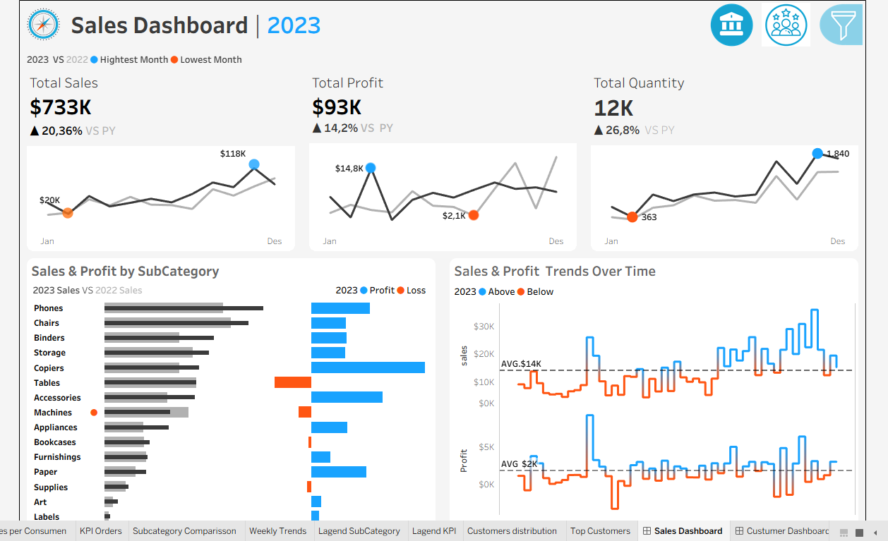
Sales Dashboard: Main View
1
KPI Overview
Total Sales, Profit, Quantity and percentage change vs last year.
2
Sales & Profit by Sub-Category
Sales bars for selected vs previous year, with profit or loss beside them.
3
Weekly Trends
Weekly sales and profit with an average line.
Blue: highest / profit / above average
Orange: lowest / loss / below average

Slide 8
Sales: KPIs & Monthly Trends
Total Sales
Total Profit
Total Quantity
$733K
$93K
12K
▲ 20.36% vs last year
▲ 14.2% vs last year
▲ 26.8% vs last year
Highest month: $118K (Nov)
Highest month: $14.8K (Mar)
Highest month: 1,840 (Nov)
Lowest month: $20K (Feb)
Lowest month: $2.1K (Aug)
Lowest month: 363 (Feb)
Insight
Sales grew 20.4% but profit only 14.2%, so margin fell from ≈13.4% (2022) to ≈12.7% (2023).
Sales and quantity were lowest in February and peaked in November. Profit peaked in March ($14.8K).
Example view with 2023 selected (compared with 2022). Choosing another year changes all figures and the comparison.

Slide 9
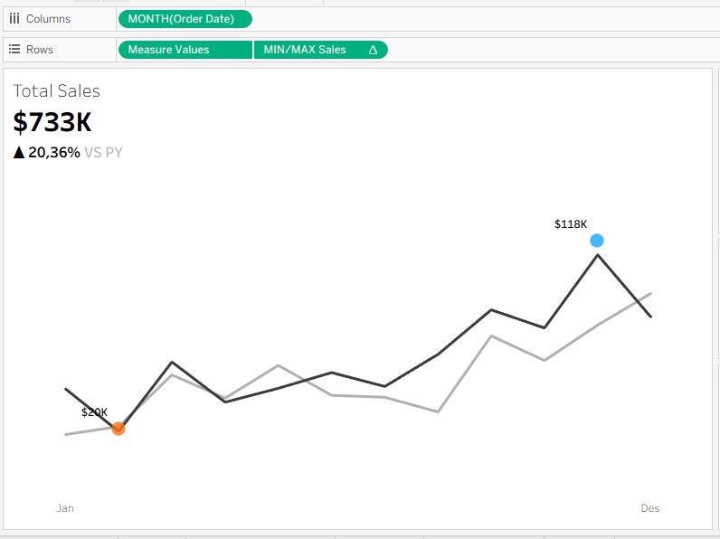
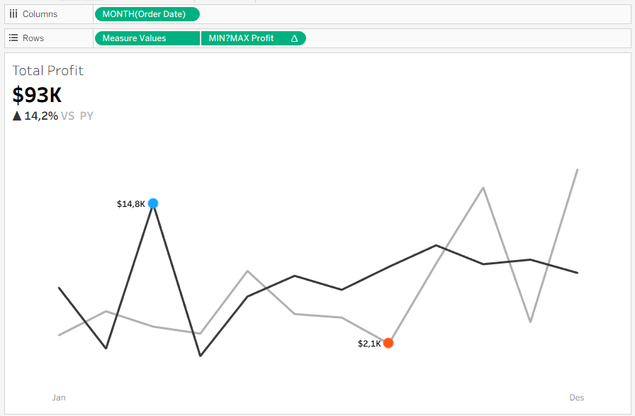
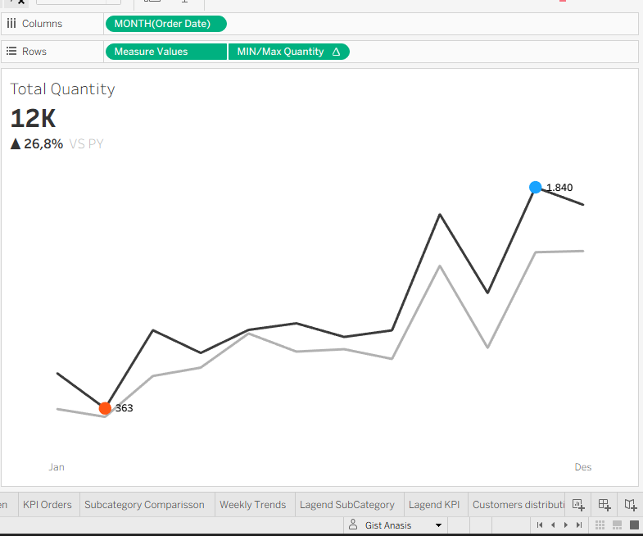
How It's Built: Sales KPI Sparklines
Total Sales
Highest $118K (Nov), lowest $20K (Feb)
Total Profit
Highest $14.8K (Mar), lowest $2.1K (Aug)
Total Quantity
Highest 1,840 (Nov), lowest 363 (Feb)
How it is built: Columns = MONTH(Order Date), Rows = Measure Values + MIN/MAX. Black line = selected year, gray = previous year.
Insight: profit does not follow the sales pattern. Sales peak in November, profit peaks in March.

Slide 10
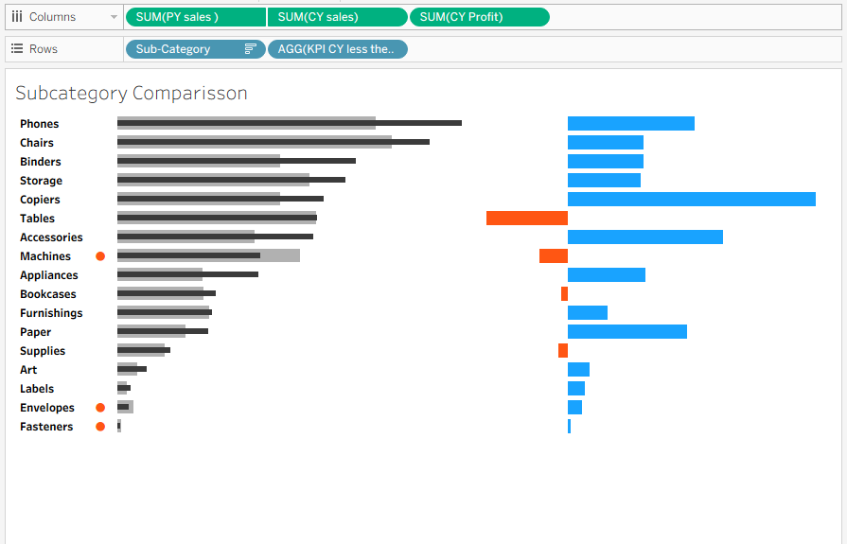
Sub-Category: Sales vs Profit
1
Chart structure
Gray = PY sales, black = CY sales. Right-hand bars = CY profit (blue profit, orange loss).
2
Orange dots
CY sales lower than PY: Machines, Envelopes, and Fasteners.
3
Loss-making sub-categories
Tables (largest), Machines, Bookcases, and Supplies. Tables has high sales but loses money.
Highest profit: Copiers, then Accessories and Phones.

Slide 11
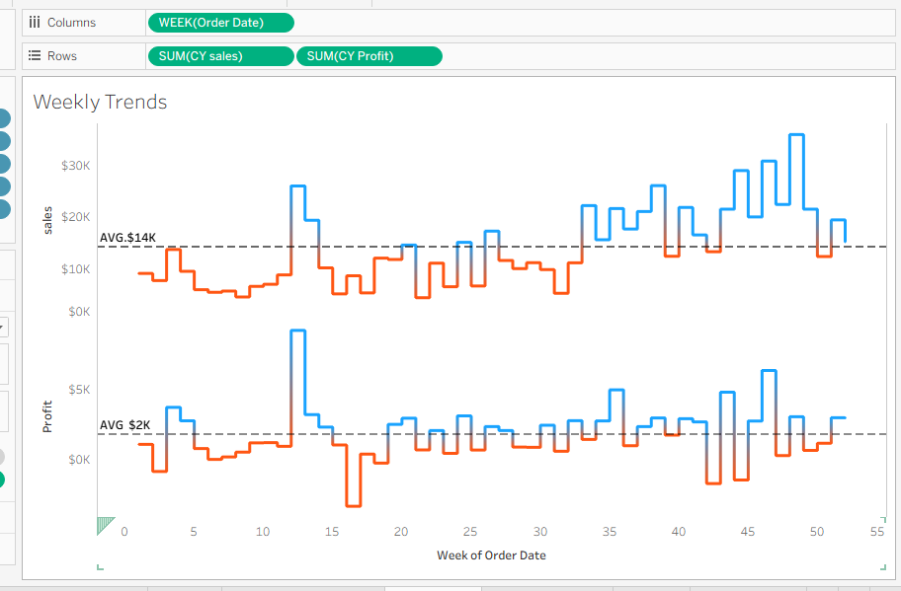
Weekly Sales & Profit Trends
1
Chart structure
X axis = week of Order Date. Dashed line = average (sales $14K, profit $2K).
2
Line colors
Blue = weeks above average, orange = below average.
3
Findings
A spike in weeks 12 to 13. Sales peak at ±$35K in week 48. Profit drops to about -$3K in week 16.
Weekly Trends sheet: two panels, sales on top and profit below.

Slide 12
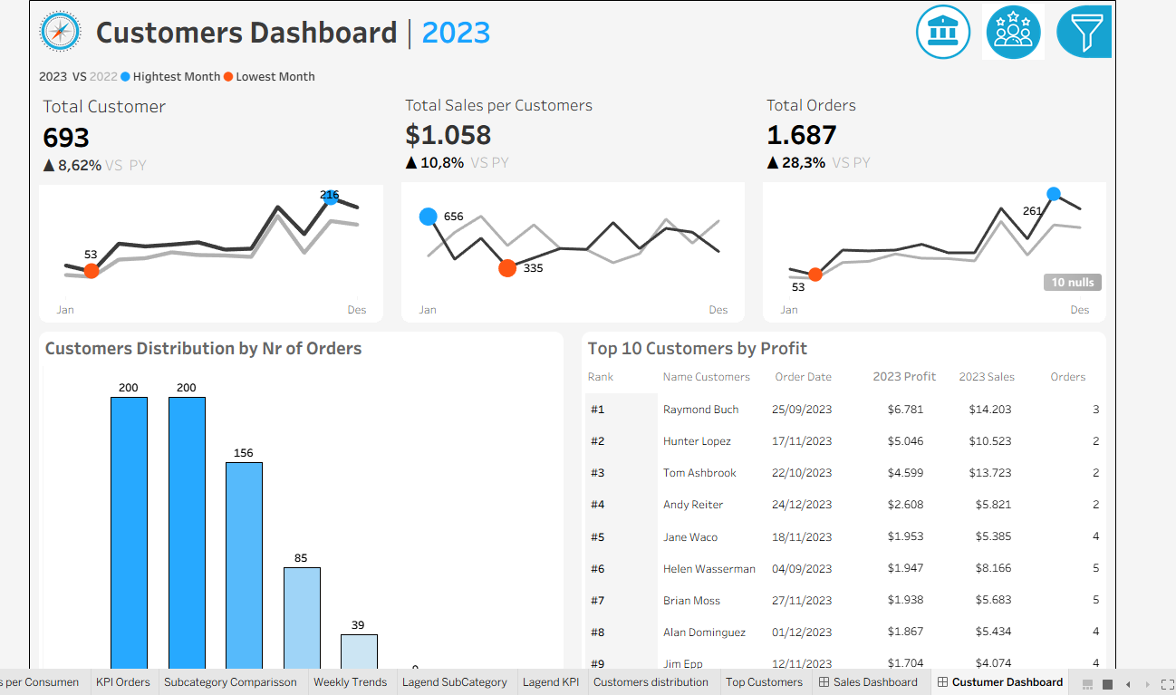
Customer Dashboard: Main View
1
KPI Overview
Total Customer, Total Sales per Customer, and Total Orders vs last year.
2
Distribution by Number of Orders
How many customers fall into each number-of-orders group.
3
Top 10 Customers by Profit
Rank, name, last order date, profit, sales, and number of orders.

Slide 13
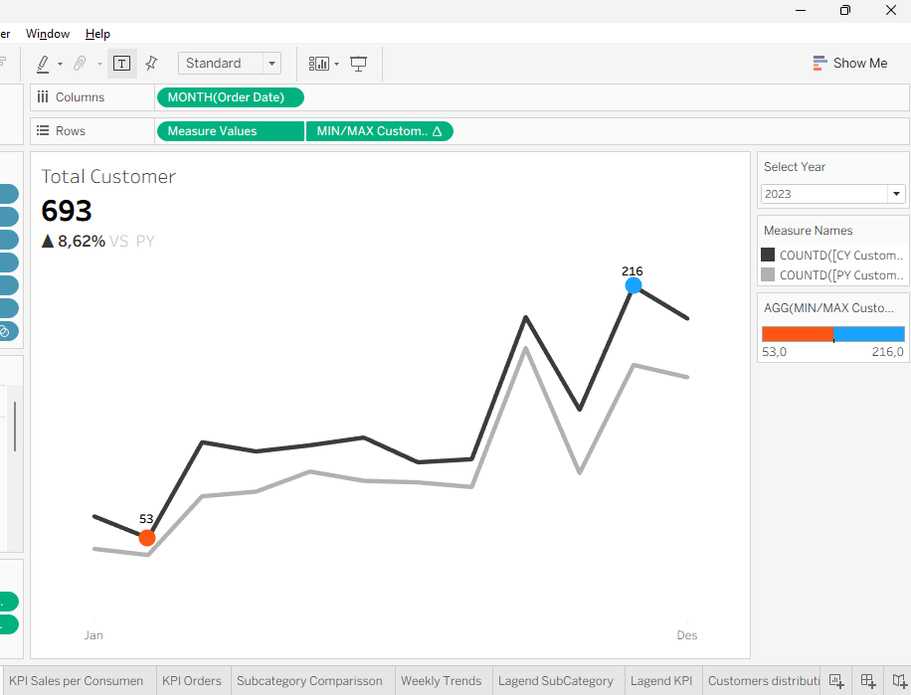
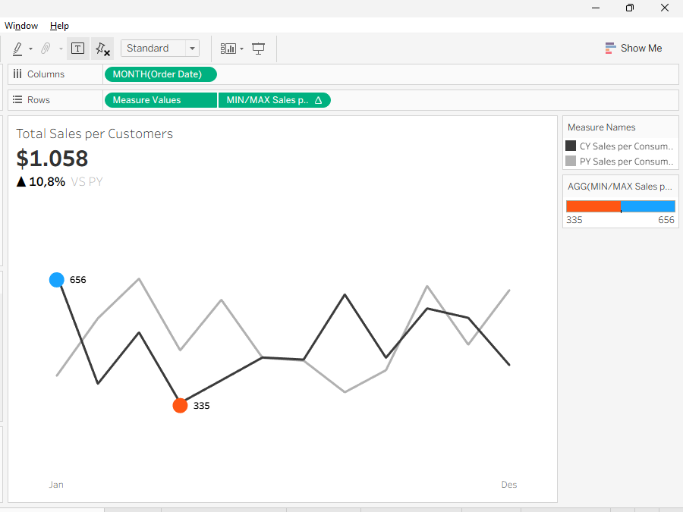
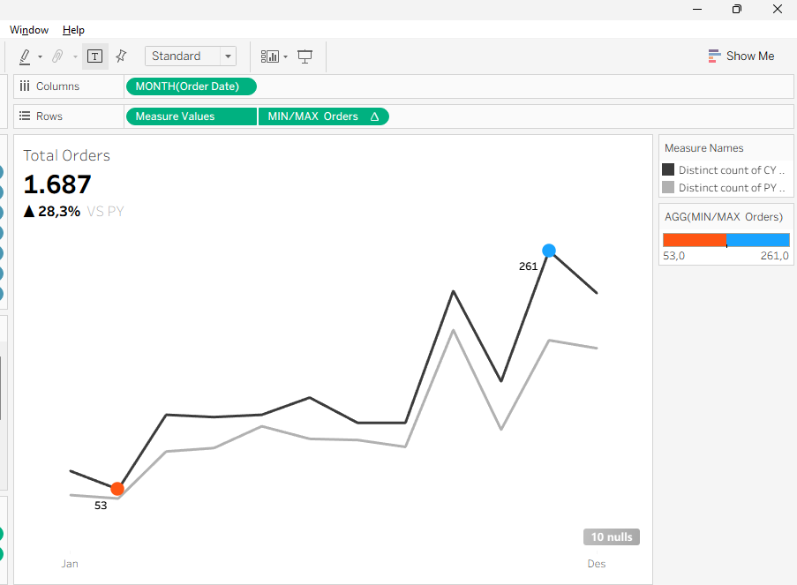
Customer: Monthly KPI Trends
Total Customer
Lowest 53 (Feb), highest 216 (Nov)
Sales per Customer
Highest $656 (Jan), lowest $335 (Apr)
Total Orders
Lowest 53 (Feb), highest 261 (Nov)
How to read: black line = selected year, gray = previous year. Blue dot = highest month, orange = lowest.
Insight: customers and orders peak at year-end, but sales per customer is highest in January.

Slide 14
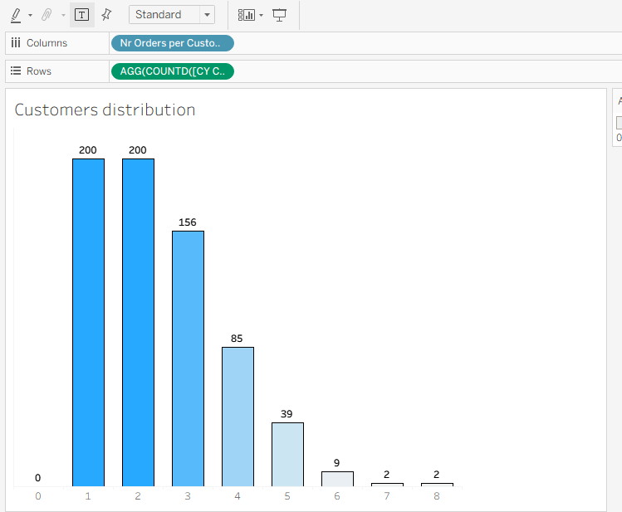
Orders per Customer Distribution
1
How it is built
X axis = Nr Orders per Customer (LOD FIXED), Y axis = number of unique customers.
2
Findings
200 customers ordered once, 200 twice, 156 three times. Only 13 customers ordered 6 to 8 times.
3
Insight
493 of 693 customers (71%) ordered more than once, a strong sign of repeat customers.

Slide 15
Customer: KPIs & Findings
Total Customer
Sales per Customer
Total Orders
693
▲ 8.62% vs last year
$1,058
▲ 10.8% vs last year
1,687
▲ 28.3% vs last year
Top customers by profit, 2023 example (USD)
Orders rose 28.3%, far above customer growth (8.6%): customers are buying more often.
Sales per customer rose 10.8% to $1,058.
The top 3 customers ≈ 18% of total profit ($93K).
71% of customers (493 of 693) ordered more than once.

Slide 16
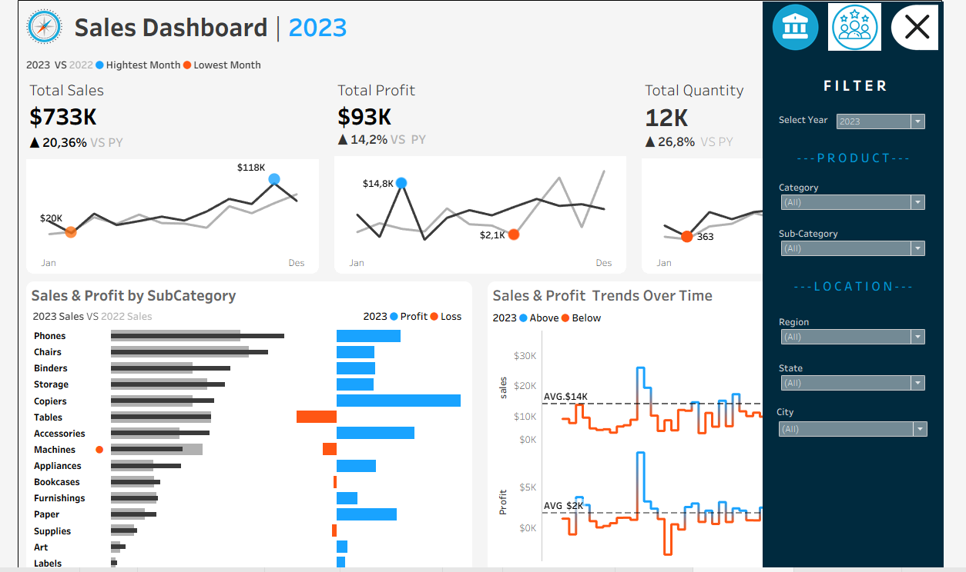





Interactivity & Filters
Select Year
Pick any year; it is automatically compared with the previous year (pick 2022 → vs 2021).
Product Filter
Category and Sub-Category.
Location Filter
Region, State, and City.
Click Charts
Charts can be used to filter the data.
Navigation
Icons at the top right to switch dashboards.
The filter panel opens from the funnel icon at the top right of the dashboard.

Slide 17
Requirements Met
Sales Dashboard
Customer Dashboard
Design & Interactivity
✓ KPI Sales, Profit, Quantity vs last year
✓ Monthly trends, highest & lowest months marked
✓ Sub-categories: sales vs profit
✓ Weekly trends, average, above/below average
✓ KPIs: Customers, Sales per Customer, Orders
✓ Monthly trends, highest & lowest points marked
✓ Customer distribution by number of orders
✓ Top 10 by profit: rank, orders, sales, profit, date
✓ Any year, auto-compared with previous year
✓ Navigation between dashboards
✓ Click charts to filter
✓ Product and location filters

Slide 18
Conclusions
The business is growing
Sales +20.4%, profit +14.2%, quantity +26.8% vs 2022 (example with 2023 selected).
1
Margin slightly lower
Profit grew slower than sales. Tables and Machines were unprofitable.
2
Customers are more active
Orders +28.3% vs customers +8.6%. 71% of customers ordered more than once.
3
Next steps: review pricing and discounts on Tables and Machines; offer a loyalty program for top customers.

